Slide 1


Investor Presentation
Premeasured I Prepackaged I Perfection

Slide 2
Forward Looking Statements
This Descriptive Presentation (the “Presentation") is being furnished solely for use by prospective parties in connection with their consideration of a potential transaction with Barfresh Food Group Inc. (the “Company”).
Prospective parties are not entitled to rely on the accuracy or completeness of the Presentation and are entitled to rely solely on only those particular representations and warranties, if any, which may be made by the Company to a party in a definitive written agreement, when, as and if executed, and subject to such limitations and restrictions as may be specified therein.
Each recipient agrees, and the receipt of this Presentation serves as an acknowledgment of, that the subject matter hereof and all of the information contained herein is of a confidential nature and that the recipient will treat such information in a confidential manner and will not, directly or indirectly, disclose or permit its affiliates or representatives to disclose any information regarding its receipt hereof or any information contained herein to any other person or reproduce, disseminate, quote or refer to this Presentation, in whole or in part, without the prior written consent of the Company.
This Presentation contains forward-looking statements and projections, which are subject to many operational and industry risks, uncertainties and assumptions, including management’s assessment of future financial performance, results of anticipated growth strategies and anticipated trends in the business and industry. There are many business factors that could cause future actual results, the level of business and financial performance to differ materially from the information expressed or implied by the forward-looking information and projections. Readers should use their knowledge of the business and industry to critically assess all forward-looking statements and projections.
Statistical information contained in this Presentation is based on information available to the Company that the Company believes is accurate. It is generally based on publications that are not produced for the purposes of securities offerings or economic analysis. The Company has not reviewed or included data from all sources and cannot assure prospective parties of the accuracy or completeness of the data included in this Presentation. Forecasts and other forward-looking information obtained from these sources are subject to the same qualifications and the additional uncertainties accompanying any estimates of future market size, revenue and market acceptance of products and services. The Company undertakes no obligation to update forward-looking information to reflect actual results or changes in assumptions or other factors that could affect those statements.
This Presentation has not been filed or reviewed by, and the securities offered hereby have not been registered with or approved by, the Securities and Exchange Commission (“SEC”) or any securities regulatory authority of any state, nor has the SEC or any such authority passed upon the accuracy or adequacy of this Presentation.
This Presentation does not constitute an offer to sell or solicitation of an offer to buy any securities. The sole purpose of this Presentation is to assist prospective parties in deciding whether to proceed with a further investigation and evaluation of the Company in connection with their consideration of a potential transaction with the Company. This Presentation does not purport to contain all information which may be material to a prospective party, and recipients of this Presentation should conduct their own independent evaluation and due diligence of the Company. Each recipient agrees, and the receipt of this Presentation serves as an acknowledgment thereof, that if such recipient determines to engage in a transaction with the Company, its determination will be based solely on the terms of the definitive agreement relating to such transaction and on the recipient’s own investigation, analysis and assessment of the Company and the transaction.
The Company reserves the right, in its sole discretion, to reject any and all proposals made by or on behalf of any prospective party with regard to a transaction with the Company, and to terminate further participation in the investigation and proposal process by, or any discussions or negotiations with, any prospective party at any time. The Company does not intend to update or otherwise revise this Presentation following its distribution.

Slide 3
Real. Fresh. Deliciousness.
Barfresh is a leader in ready-to drink and ready-to-blend frozen beverages for high-volume operations.
It’s no secret that people are more obsessed than ever with living a healthier lifestyle and feeding their bodies with fresh and simple foods. Barfresh founder, Riccardo Delle Coste recognized the growing “better for you” trend early in 2005 and developed a proprietary, patented “whirl class” system that made serving freshly blended frozen beverages quick, easy and cost efficient.
Our Twist & Go, Single-Serve and Easy-Pour Bulk products have transformed the blended beverage industry for smoothies, shakes and frappes made with fresh fruit and other natural ingredients.

Slide 4
Total Addressable Market & Products

Slide 5
Market Opportunity
Smoothie market growing almost double rate of already strong healthy foods category!
5.3% CAGR
10.1% CAGR
* Source: Statista 2022
Marketing Data Forecast (Jan, 2024)

Slide 6
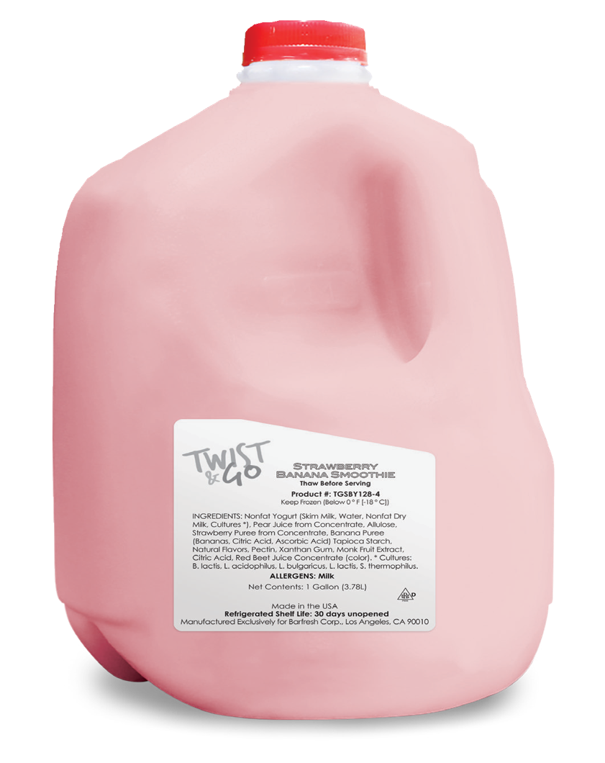
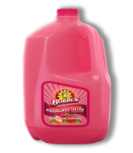
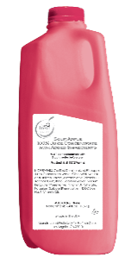
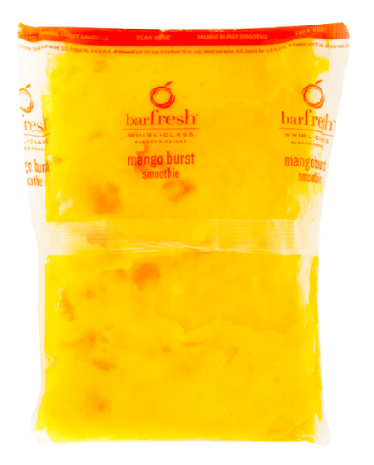
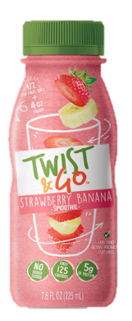
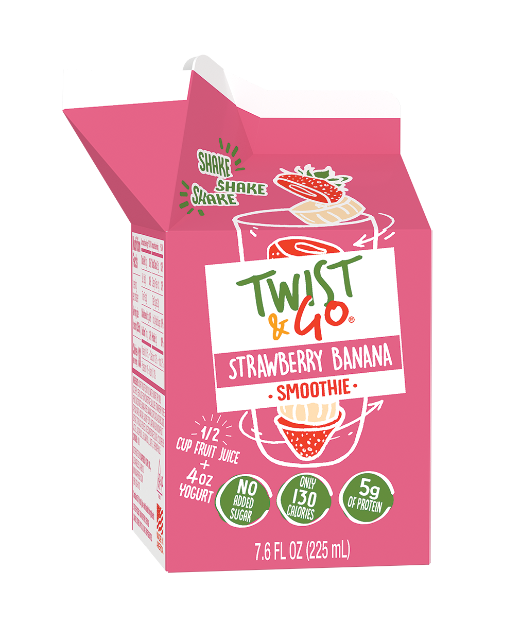
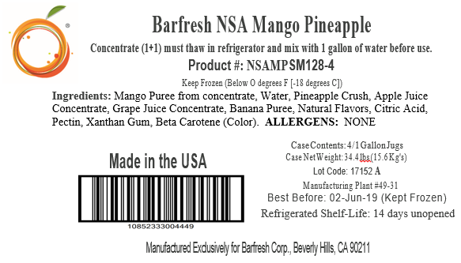
The Products
Ready to Drink Products Ready To Blend Concentrate Products
Twist & Go Single Serve Easy Pour Bulk 100% Juice Refreshers

Slide 7






Barfresh’s Diverse Sales Channels
Education
Military
National Quick Service Restaurants (“QSRs”)
Recreation, Amusement & Tourism
Third Party Operators
Business & Industry

Slide 8


Barfresh’s Differentiated Single Serve Product & Process
Operational Simplicity
Ingredients
Perfect consistency every time Makes a smoothie in approx. 1 minute Only equipment needed: Blender | No waste, no spoilage Reduces labor No complicated installation Portion controlled
No artificial colors or flavors Premium taste Clean labeling | Real fruit Gluten free Kosher certified
In Less Than a Minute!

Slide 9
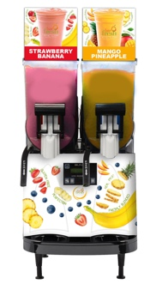

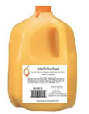
Barfresh’s “Easy Pour” Bulk Format Solution
Response to customers requiring rapid speed of service
The Barfresh Process
Barfresh Bulk Solution
1
2
3
+
+
=
Any size finished
smoothie
1 gallon of
concentrate
1 gallon of
water
Flexible Solution Can Fit with Customer’s Existing Equipment

Slide 10

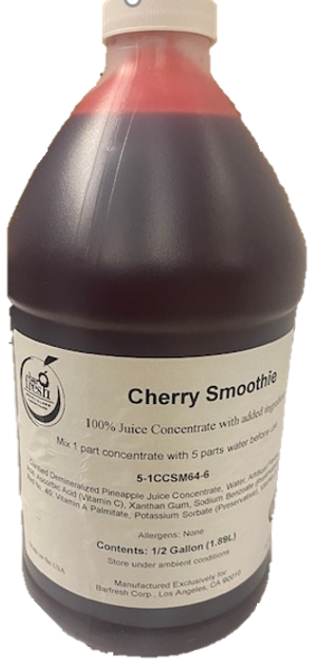
Barfresh’s 100% Juice Concentrates for Schools
4g of Protein and 220g of Potassium, including Vitamin D, Calcium, Iron & Vitamin C
  No Preservatives
    No Artificial Flavors or Colors
      No Sugar Added
        Non-GMO and Gluten Free
          10 Exciting Flavors
Compliant with USDA Reimbursable Meal Programs and Smart Snack compliant
10
© 2020 BarFresh Food Group Inc. All rights reserved.

Slide 11
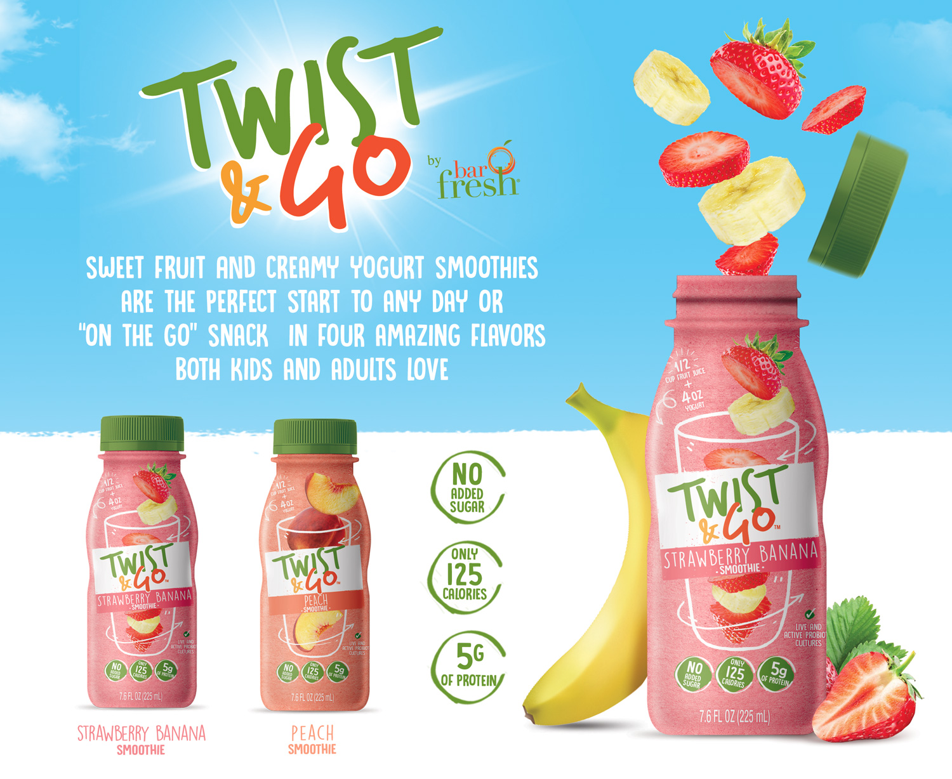
Barfresh’s Bottled, Ready-to-Drink
Solution for Schools
4 Ounces of Yogurt and ½ Cup of Fruit/Fruit Juice
  No Preservatives
    No Artificial Flavors or Colors
      No Sugar Added
        125 Calories
          5 Grams of Protein
Compliant with USDA Reimbursable Meal Programs and Smart Snack compliant
11
© 2020 BarFresh Food Group Inc. All rights reserved.

Slide 12

Elementary and Secondary
School Accounts
REAL FRUIT
No Preservatives
Massive market potential¹
  School students in the United States
No Artificial Flavors or Colors
  13K
  districts
  131K+
  schools
No Sugar Added
Non-GMO
Gluten-Free
  Twist & Go and WHIRLZ offerings dramatically increase growth opportunities.
Meets breakfast meal pattern regulations
Source: Research.com and National Center for Education Statistics, Department of Education, Table 105.20. Edweek.org
  Is USDA Smart Snack Compliant
  Meets the “Buy American” requirement

Slide 13
Education - Opportunity
Enormous amount of runway with Twist & Go
Emphasis of healthy options…..especially in underprivileged areas
  Importance of breakfast in academic performance is frequently documented
  Twist & Go is the first chance to try a smoothie for some kids
  Continued bi-partisan political momentum for free meals in schools
  TWIST & GO increases breakfast participation rate by 40%*
Great feedback from parents, students and administrators alike
  Twist & Go is a product that kids, parents, administrators and Nutritional Directors are excited about
  All are thrilled to see the kids happy to eat a healthy product!
  Company has begun to turn the corner after navigating supply challenges over the past couple of years
* Bellingham, WA, Public Schools

Slide 14
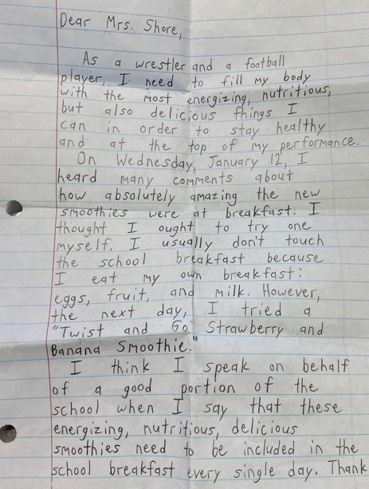
What Our Education Customers Say……
Excited to be launching Twist & Go! A big thank you to Barfresh for making such a nutritious product that both the dieticians and students are sure to love!
– Stephanie, Pasco County Schools
I haven’t heard from our high school yet, but Pulaski County Middle -----YES with rave reviews, especially the strawberry/banana and mango pineapple….. It is very exciting that there is a product we don't have to mix ourselves and tastes so delicious!!
- Elaine, Pulaski County Schools
I literally just had a call from our middle school and she reported that she sold 40% more breakfast today because of the smoothies!!!
- Mataio, Bellingham, WA, Schools
The 4th grade, especially my entire class, would like to let you know we are in complete love with the smoothies and hope we get it more often!
- Janie, Anne Arundel County Schools

Slide 15

U.S. Armed Forces
Accounts
Military
  Received approval from the United States Defense Logistics Agency (DLA) to sell smoothie products into all branches of the U.S. Armed Forces
  Expanded military channel locations domestically and now pouring product internationally in South Korea
  Completed stringent
  12mos+
  military approval process
  Barfresh’s Easy Pour Bulk Smoothies available to military food service programs supporting dining facilities
  Smoothies available 365 days a year / 3 meals per day to enlisted personnel as part of their meal service program
  Barfresh is pursuing Global Military bases, which support its 1.3 million active troops
  Were awarded a five-year contract to supply the AAFES School Meal Program!
    To service 76 Army & Air Force school installations

Slide 16









High Profile Restaurants, Colleges and Recreational Sites Are Also Targets For Our Ready-to-Blend Products

Slide 17







Strong Distribution Relationships in Place

Slide 18

Scalable Manufacturing Capabilities & Relationships
Flexible Operating Model Provides
Opportunity to Scale Quickly
Utilize multiple contract manufacturers that provide Barfresh efficient national coverage:
Barfresh-owned packaging equipment for certain locations positioned on manufacturing line to work seamlessly with contract manufacturer’s equipment
and infrastructure
Procurement-related synergies
Allows maximum flexibility to manage volume fluctuations and start up requirements

Slide 19
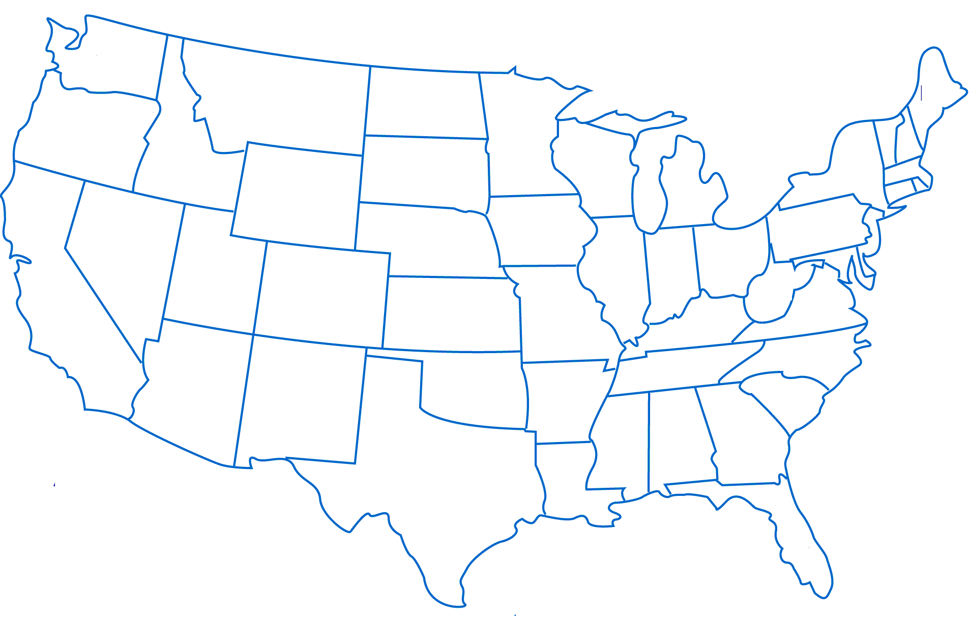
Supply Chain In Place To Meet Increased Demand
Alignment with major freight partner enhances Barfresh’s ability to service customers across North America
    Inventory strategically located at centralized warehouse managed with major freight consolidation partner
    System facilitates quicker order fulfillment, and enables customers to order less than full pallet orders on a weekly basis to directly address specific customer requirements
    Ability to achieve full truckload rates on multi-product line orders as our business gains scale with distribution partners
Chicago

Slide 20
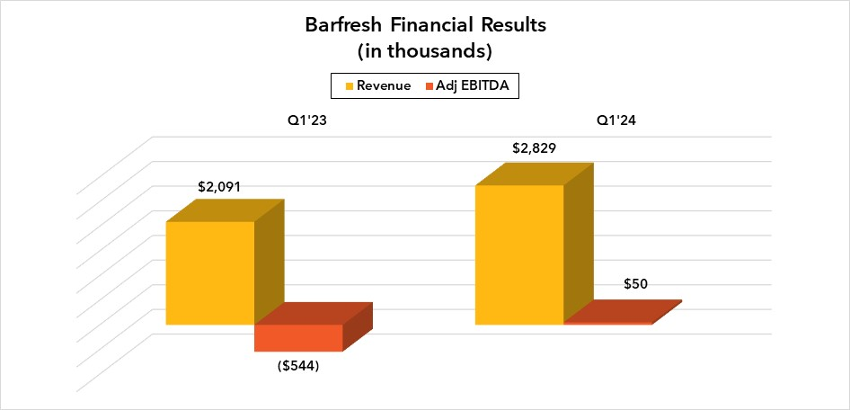
Financials
Highlights:
Record revenue in Q1’24
35% YoY Revenue Growth over Q1’23
Expecting record revenue for 2024
Adjusted EBITDA positive in Q1’24 – First time in Barfresh History!

Slide 21
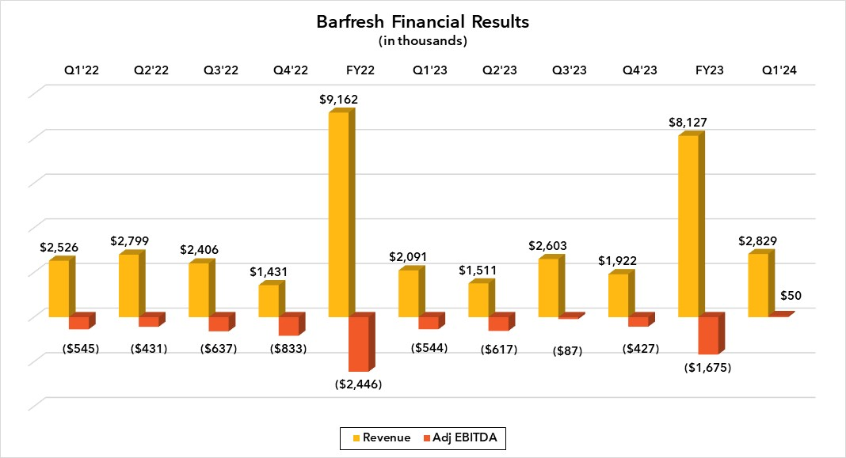
Financials
Highlights:
Revenue trajectory interrupted in Q3’22 due to product issues at primary co-manufacturing partner
Bottle capacity expansion expected with new co-manufacturer in place prior to start of 2024/25 school year
Prior to disruption, the Company had experienced 130% YoY revenue growth driven by Twist & Go products
Strong opportunity to overcome seasonality of school business through placement of Single Serve ready-to-blend product with a National QSR and introducing Twist & Go to retail channel

Slide 22
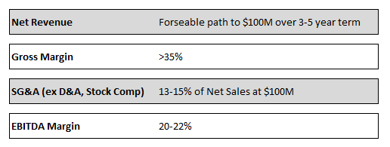
Medium-term Business Model Targets

Slide 23
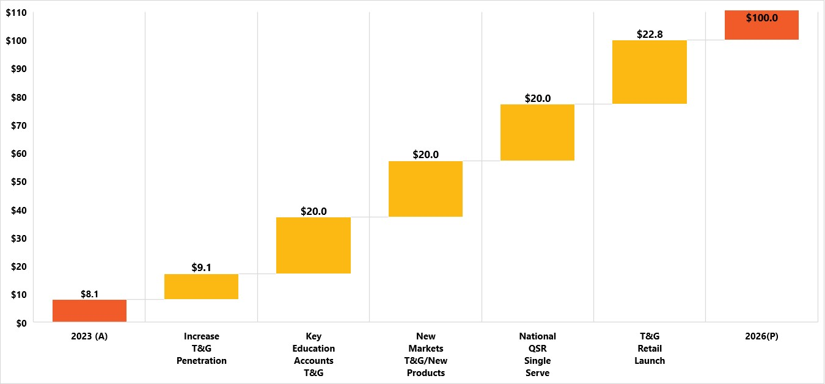
Path to $100M Revenue
Increase Penetration – Before product issues, we were in 20 states with a significant penetration in 4; situation is largely unchanged due to capacity constraints after losing co-packer production
Key Education Accounts – Land 2 of 10 top school districts representing opportunity of $10-15M annually each
New Markets – Signed network of K-12 brokers in Q2’22 to broaden reach in additional whitespace states; currently covering approximately 40 states. Develop or acquire new products to put through education channel
National QSR – Place Single Serve in a national restaurant chain; prior discussions contemplated revenue projections of $25-50M
Launch Retail - $20-25M opportunity; plan to dovetail off K-12 brand recognition to minimize promotion expense

Slide 24
Key Takeaways
Achieved record revenue in Q1 2024 and record revenue expected for full year 2024. Scalable business model. Achieved breakeven Adjusted EBITDA in Q1 2024 for first time in Company history!
A clean balance sheet, no debt, a strong cash position
Re-engaging national QSRs for ready-to-blend single serve smoothies
Well positioned to increase penetration in the education channel - currently minimal. A huge opportunity remains in front of the Company!
An on-trend product portfolio
© 2024 Barfresh Food Group Inc. All rights reserved.

Slide 25









Experienced Management Team
The Company
  Headquarters: Los Angeles, CA
  NASDAQ: BRFH
Executive | Position | Yrs. | Select Prior Experience
Riccardo Delle Coste | Founder & Chief Executive Officer | 25
Lisa Roger | Chief Financial Officer | 29
Tony Grossi | Vice President of Sales | 25
Marko Matla | Vice President Supply Chain and Co-Manufacturing | 27

